Slide 1
Mental Health Literacy WORKSHOP

Slide 2
Mental Health Literacy WORKSHOP
Was designed to…
raise awareness and understanding of mental health among student-athletes
decrease mental health stigma
raise understanding of how dual careers can impact student-athletes mental health
encourage student-athletes to seek help & support when dealing with MH problems
acquaint student-athletes with existing sources of support within their DC environment

Slide 3
Mental Health Literacy WORKSHOP
After today‘s workshop:
Familiarity and the ability to use the MH Literacy workshop with your student-athletes / on your own.
Higher awareness of the importance of mental health among student-athletes and the sources of support that are available in your DC environment.
Deeper insight into how dual careers can impact student-athletes mental health.

Slide 4
Before diving in…
… let‘s clarify the terms used in this workshop:
Mental health (MH)
MH problems/struggles vs. mental ill-health
MH stigma

Slide 5
Mental Health Literacy QUIZ
MH Literacy tool
5 – 10 minutes to complete the quiz
Can be used as a teaser at the beginning of the workshop.

Slide 6
Now let‘s look at the manual!

Slide 7
Mental Health Literacy WORKSHOP
Mental health stigma
(90 minutes)
Mental health and dual career
(75 minutes)
Seeking help and support
(75 minutes)
The workshop is divided into 3 sections:
Each section consists of:
Theoretical explanation
Learning outcomes of the section
List of required materials
Set of activities (2-3 per section) with detailed instructions
The format of the workshop allows two versions: for individual use and for use in groups

Slide 8
Part 1: Mental health stigma

Slide 9
Part 1: Mental health stigma
Activity 1.1: Defining stigma
Questions to lead the discussion:
What negative things have you heard people say about MH problems?
Why do you think MH conditions are stigmatized?
How do you think stigma affects the lives of people with MH problems?
What could you do to reduce the stigma of mental illness?

Slide 10
Activity 1.1: Closing the activity
What could you do to reduce MH stigma? Examples:
Talk openly about mental health.
Help to normalize mental health care.
Learn more about mental illness.
Listen to people who have experienced mental illness, and show compassion to them.
Be conscious of your language
Encourage equality between physical and mental illness.
Share supportive messages about mental health on social media.

Slide 11
Part 1: Mental health stigma
5 minutes,
in pairs
Activity 1.2: Common myths and realities of MH conditions
If you have a mental health problem it's better to hide it from others.
Everyone with
a mental health problem will get better if they only have the willpower to do so.
If you have mental health problems, you cannot be successful in sport and/or school.
Can you identify yourself with the statement?
Do you believe the statement is correct? Why (not)?
What are the possible outcomes/consequences of this belief?

Slide 12
Part 1: Mental health stigma
Activity 1.3: Famous athletes who reported facing MH problems
Simone Biles
Ian Thorpe
David Beckham
Michael Phelps
Serena Williams
Lindsey Vonn
What are her/his greatest athletic achievements?
What can you find about his/her MH challenges?

Slide 13
Part 2: Mental health and dual career

Slide 14
Part 2: Mental health and dual career
8 minutes,
individual work
Activity 2.1: Dual career and MH
Domain | What elevates my/athletes‘ MH and wellbeing? | What decreases my/athletes‘ MH and wellbeing?
School (Education)
Sport (Athletic career)
Combination of school and sport

Slide 15
Part 2: Mental health and dual career
Activity 2.2: Taking care of my mental health and wellbeing
Think about the day-to-day (possibly small) things that help you keep healthy, experience positive emotions, and/or have a sense of purpose and meaning in life. Make a list of these activities/things.

Slide 16
Part 3: Seeking help

Slide 17
Part 3: Seeking help
Which was the scenario most likely to actually happen out of those you discussed?
Activity 3.1: Getting help
What to do in this situation?
Your teammate seems really down and talks about dropping out of sport.
Were there any disagreements in the groups about what was best to do?
Your friend at sport is on a diet and is visibly losing weight. He/she is getting really skinny and never seems to eat. He/she still thinks he/she s too fat and feels ashamed of being in revealing clothing.
You are constantly worried about school and find yourself having difficulties falling asleep or waking up at night. Because of worries, you face difficulties to keep concentrated at school and trainings.

Slide 18
Part 3: Seeking help
Activity 3.2: Identifying sources of support
Self-reflection:
Seeking help and support when we need it is considered to be normal. However, how do you feel about seeking help when dealing with difficult issues? Are you inclined to ask for help and support in such situations? Why (not)?
If you (would) need support at this moment – where would you seek it?
If your best teammate or friend would need help with dealing with mental health issues – what would you recommend to him/her? Where would you advise him/her to seek help?

Slide 19
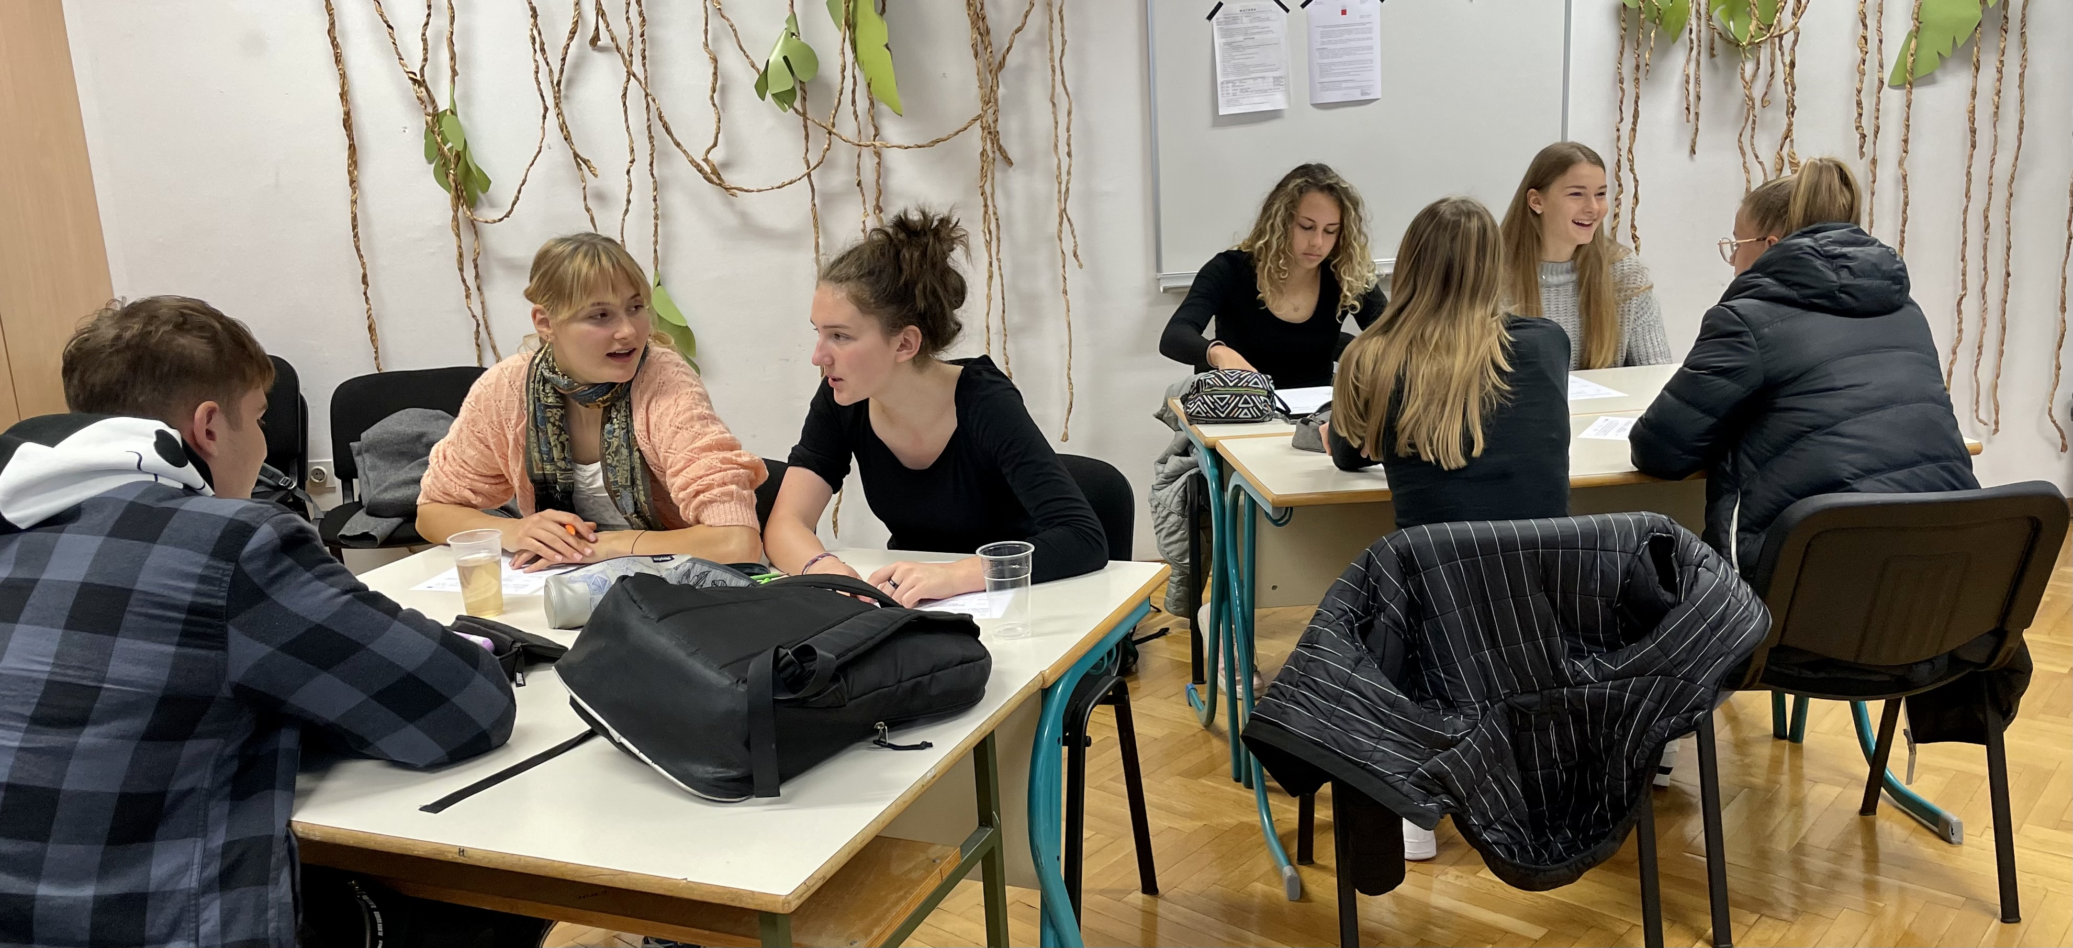
Part 3: Seeking help
Activity 3.2: Identifying sources of support
Try to identify as many sources of support within:
Your educational institution
Your sport organization
Elsewhere

Slide 20
Part 3: Seeking help
5 minutes,
individual work
Activity 3.2: Identifying sources of support
Try to identify as sources of support for student-athletes who are dealing with MH problems within your DC organisation / sport organization / educational institution.

Slide 21
Mental Health Literacy WORKSHOP
Questions? ☺

